Slide 1
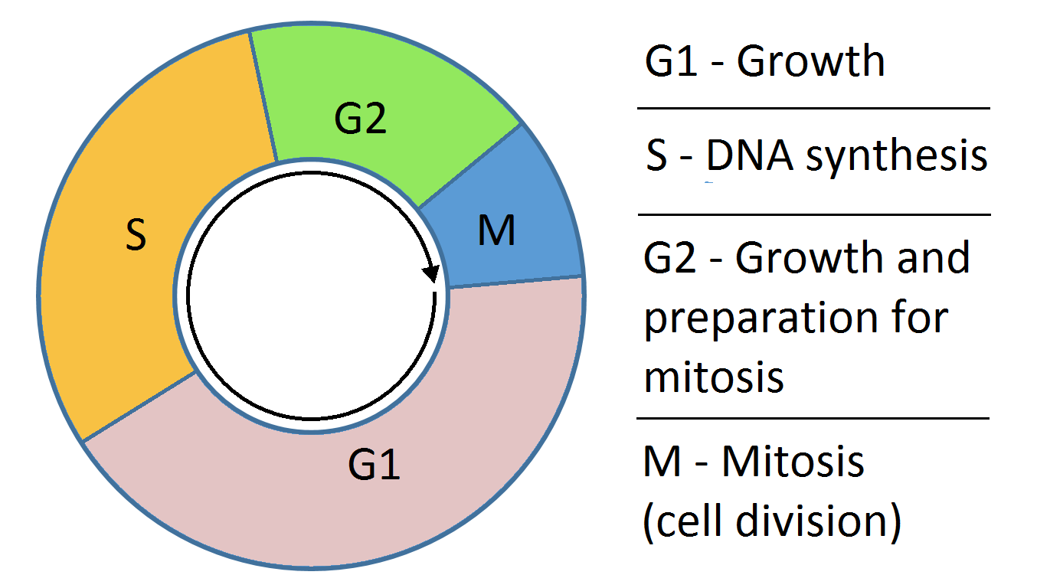
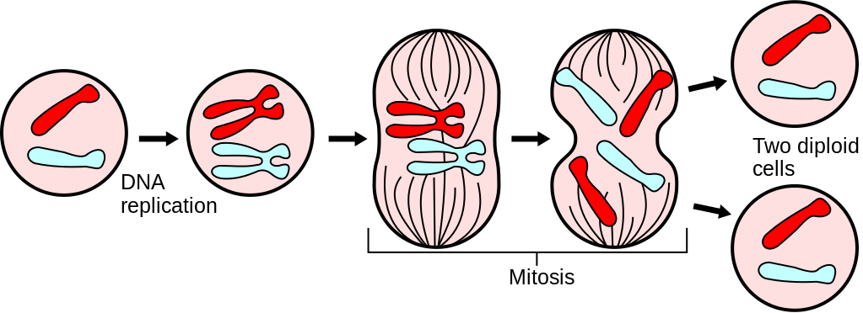
A Bifurcation Analysis on the Biochemical Switches of the G1-S Transition of the Mammalian Cell Cycle
Presented by: Mike Huang, Chih-Chi Liu

Slide 2
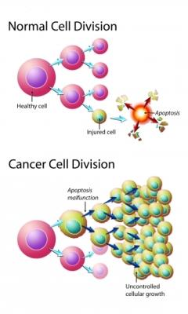
Background
Cell cycle contains many checkpoints that must be met to ensure all of the requisite processes occurs before cell division continues.
Errors result in uncontrolled growth - cancer

Slide 3
Biochemical Switches of the G1-S Transition
Phosphorylation Cascade
Phosphorylation Cascade
Transcription Factor Promoter Cyclin D
Transcription Factor
E2F-1
Transcription Factor Promoter Cyclin E
DNA synthesis (S-phase)

Slide 4
Cyclin D and Cancer
Cyclin D: an oncogene with pathogenic role in many tumors
Overexpression of cyclin D found in several types of tumor formation

Slide 5
Specific Aims of the Study
Study the contribution of cyclin D and cyclin E on cell proliferation and quiescnece by manipulating their synthesis and degradation rates
Can the framework make predictions that can lead to interventions to tumorigenesis?
5

Slide 6
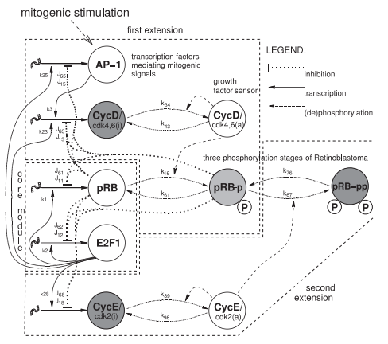
Schematics of the Model
G1-S progression
E2F-1 bound to tumor suppressor, pRB
Input growth signal: Mitogenic stimulation promotes synthesis of transcription factor promoter, cyclin D
Two phosphorylation cascades promotes the phosphorylation of pRB in a two stage process:
Cyclin D:cdk4,6 complex
Cyclin E:cdk2 complex
Phosphorylation of pRB releases E2F-1 so that it’s active
DNA synthesis: S-phase
6
Notes:
How they estimated the parameters

Slide 7
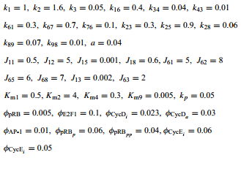
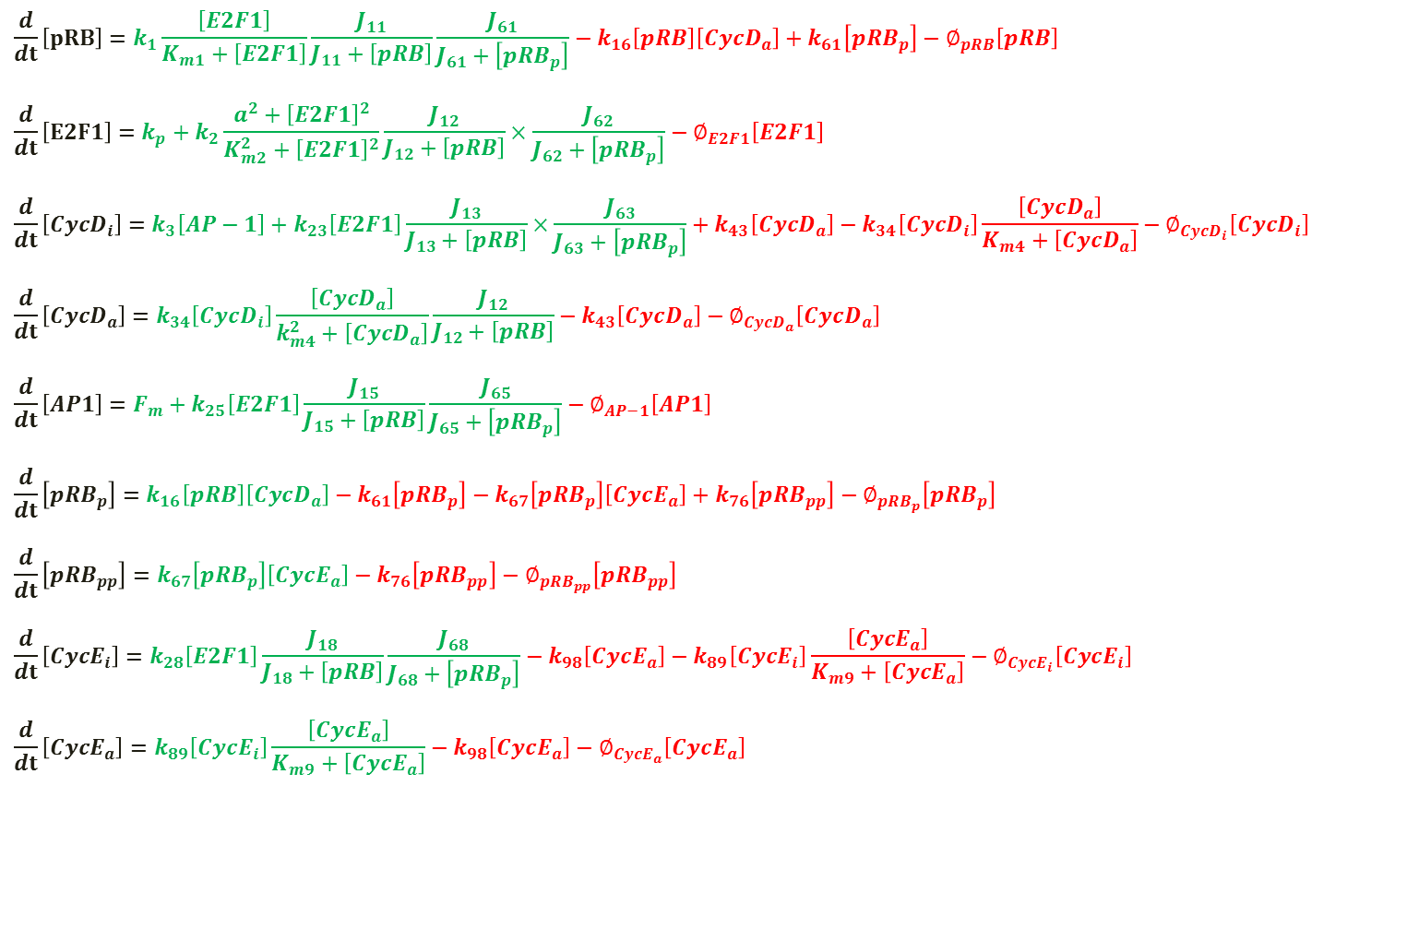
$$\frac{d}{dt}\left[pRB\right]=k_{1}\frac{\left[E2F1\right]}{K_{m1}+\left[E2F1\right]}\frac{J_{11}}{J_{11}+\left[pRB\right]}\frac{J_{61}}{J_{61}+\left[{pRB}_{p}\right]}−k_{16}\left[pRB\right]\left[{CycD}_{a}\right]+k_{61}\left[{pRB}_{p}\right]−∅_{pRB}\left[pRB\right]$$
$$\frac{d}{dt}\left[E2F1\right]=k_{p}+k_{2}\frac{{a^{2}+\left[E2F1\right]}^{2}}{K_{m2}^{2}+{\left[E2F1\right]}^{2}}\frac{J_{12}}{J_{12}+\left[pRB\right]}×\frac{J_{62}}{J_{62}+\left[{pRB}_{p}\right]}−∅_{E2F1}\left[E2F1\right]$$
$$\frac{d}{dt}\left[{CycD}_{i}\right]=k_{3}\left[AP−1\right]+k_{23}\left[E2F1\right]\frac{J_{13}}{J_{13}+\left[pRB\right]}×\frac{J_{63}}{J_{63}+\left[{pRB}_{p}\right]}+k_{43}\left[{CycD}_{a}\right]−k_{34}\left[{CycD}_{i}\right]\frac{\left[{CycD}_{a}\right]}{K_{m4}+\left[{CycD}_{a}\right]}−∅_{{CycD}_{i}}\left[{CycD}_{i}\right]$$
$$\frac{d}{dt}\left[{CycD}_{a}\right]=k_{34}\left[{CycD}_{i}\right]\frac{\left[{CycD}_{a}\right]}{k_{m4}^{2}+\left[{CycD}_{a}\right]}\frac{J_{12}}{J_{12}+\left[pRB\right]}−k_{43}\left[{CycD}_{a}\right]−∅_{{CycD}_{a}}\left[{CycD}_{a}\right]$$
$$\frac{d}{dt}\left[AP1\right]=F_{m}+k_{25}\left[E2F1\right]\frac{J_{15}}{J_{15}+\left[pRB\right]}\frac{J_{65}}{J_{65}+\left[{pRB}_{p}\right]}−∅_{AP−1}\left[AP1\right]$$
$$\frac{d}{dt}\left[{pRB}_{p}\right]=k_{16}\left[pRB\right]\left[{CycD}_{a}\right]−k_{61}\left[{pRB}_{p}\right]−k_{67}\left[{pRB}_{p}\right]\left[{CycE}_{a}\right]+k_{76}\left[{pRB}_{pp}\right]−∅_{{pRB}_{p}}\left[{pRB}_{p}\right]$$
$$\frac{d}{dt}\left[{pRB}_{pp}\right]=k_{67}\left[{pRB}_{p}\right]\left[{CycE}_{a}\right]−k_{76}\left[{pRB}_{pp}\right]−∅_{{pRB}_{pp}}\left[{pRB}_{pp}\right]$$
$$\frac{d}{dt}\left[{CycE}_{i}\right]=k_{28}\left[E2F1\right]\frac{J_{18}}{J_{18}+\left[pRB\right]}\frac{J_{68}}{J_{68}+\left[{pRB}_{p}\right]}−k_{98}\left[{CycE}_{a}\right]−k_{89}\left[{CycE}_{i}\right]\frac{\left[{CycE}_{a}\right]}{K_{m9}+\left[{CycE}_{a}\right]}−∅_{{CycE}_{i}}\left[{CycE}_{i}\right]$$
$$\frac{d}{dt}\left[{CycE}_{a}\right]=k_{89}\left[{CycE}_{i}\right]\frac{\left[{CycE}_{a}\right]}{K_{m9}+\left[{CycE}_{a}\right]}−k_{98}\left[{CycE}_{a}\right]−∅_{{CycE}_{a}}\left[{CycE}_{a}\right]$$

Slide 8
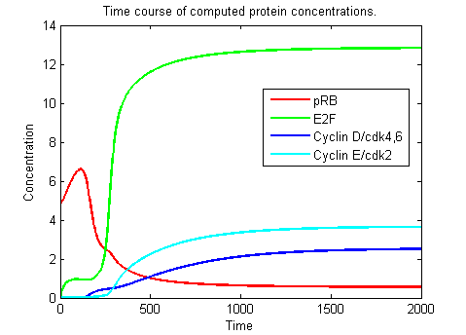
Bistability: A Switch to Cell Proliferation
Mitogenic Stimulation increased above threshold (Saddle Node)
E2F1 jumps to higher steady state (Bistability)
DNA Synthesis (S-phase)

Slide 9
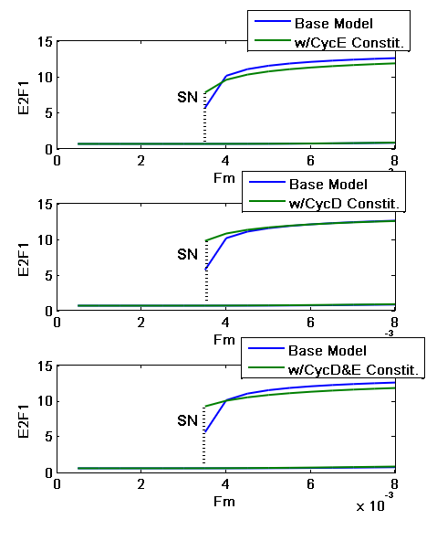

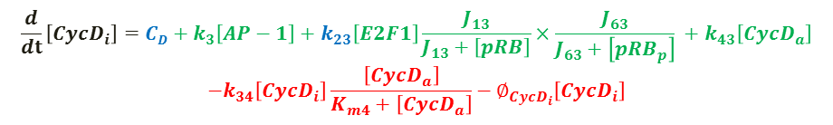
Adding Constitutive(Basal) Synthesis Rate to Cyclin D/Cyclin E
Motivation: Experimental studies involve overexpression of the constitutive synthesis rate
- Can this model describe experimental phenomena?
$$\frac{d}{dt}\left[{CycD}_{i}\right]={CD+k}_{3}\left[AP−1\right]+k_{23}\left[E2F1\right]\frac{J_{13}}{J_{13}+\left[pRB\right]}×\frac{J_{63}}{J_{63}+\left[{pRB}_{p}\right]} +k_{43}\left[{CycD}_{a}\right]$$
$$−k_{34}\left[{CycD}_{i}\right]\frac{\left[{CycD}_{a}\right]}{K_{m4}+\left[{CycD}_{a}\right]}−∅_{{CycD}_{i}}\left[{CycD}_{i}\right]$$
$$\frac{d}{dt}\left[{CycE}_{i}\right]={CE+k}_{28}\left[E2F1\right]\frac{J_{18}}{J_{18}+\left[pRB\right]}\frac{J_{68}}{J_{68}+\left[{pRB}_{p}\right]}$$
$$−k_{98}\left[{CycE}_{a}\right]−k_{89}\left[{CycE}_{i}\right]\frac{\left[{CycE}_{a}\right]}{K_{m9}+\left[{CycE}_{a}\right]}$$
9
Notes:
List 9 important components
Run through the mechanisms
Authors cite past experimental studies that rigorously determined a range of molecules and processes in the network
Authors selected nine of these components they “believed” to be the most important in controlling the G1-S transition

Slide 10
Assumption and Limitation of the Method
Constitutive:E2F1 dependent synthesis ratio unknown experimentally in normal healthy cell.
Validity of some of the mechanisms are questionable
Ex: Model shows a negative autoregulation of pRB without citing this. pRB was shown to be positively autoregulated by itself in past study. (Park 1994)

Slide 11
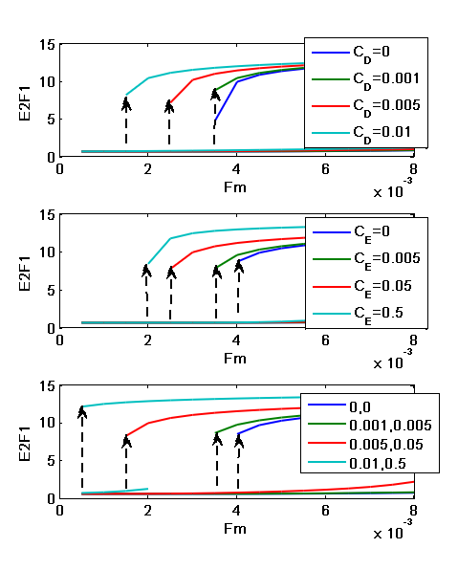
Results: Overexpression in the Cyclin D and Cyclin E Induces Cell Proliferation
Overexpressing the Constitutive Synthesis of Cyclins shortening the G1 phase
Results found in observed experimental phenomena
Chinese hamster ovary cell: overexpression of cyclin E -> cell proliferation
Rate esophageal tumor: both cyclin E and cyclin D are overexpressed

Slide 12
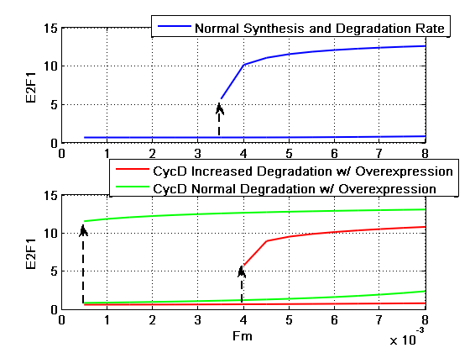
Results: Inducing Degradation of Cyclin D
Inducing degradation of cyclin D results in quiescence
ϕCycDi=0.023 -> 0.04
ϕCycDa=0.03 -> 0.05
Increasing degradation of Cyclin D shifted the SN to the right
12

Slide 13
Pharmaceutical Intervention to Induce Cell Arrest
Block expression of cyclin D/E
Cyclin D: Troglitazone, anasamycin, monoterpenes
Cyclin E: 17alpha-ethinyl estradiol
Induce degradation of cyclin D
Hypothemycin, GL331, Reservatrol, Lovastatin

Slide 14
Pharmaceutical Intervention to Induce Cell Arrest
Block expression of cyclin D/E
Cyclin D: Troglitazone, anasamycin, monoterpenes
Cyclin E: 17alpha-ethinyl estradiol
Induce degradation of cyclin D
Hypothemycin, GL331, Reservatrol, Lovastatin
Conclusion
Ability to control cell proliferation and cell arrest by controlling the expression of cyclin D/E
Overexpression of cyclins -> cell proliferation
Repression of cyclins -> cell arrest

Slide 15
Limitations of Study
The model is incomplete and simplified
Number of mechanisms and bimolecular interactions found in other paper is neglected
The model makes the assumption of double-inhibition double activation interactions between E2F1-pRB as a way to generate bistability
The parameters are not measured but rather are qualitative to have certain qualitative features
There is no quanitative data validation

Slide 16
Path Forward
Study the significance of cdk2/cdk4,6 in the G1/S transition
Vary the activation and inactivation of cyclin E and cyclin D, respectively
k₃₄/k₄₃ for cyclin D and k₉₈/k₈₉ for cyclin E
Adding inhibitor to block cyclinE:cdk2/cyclinD:cdk4,6 complex
Study the negative feedback that leads to oscillations
16

Slide 17
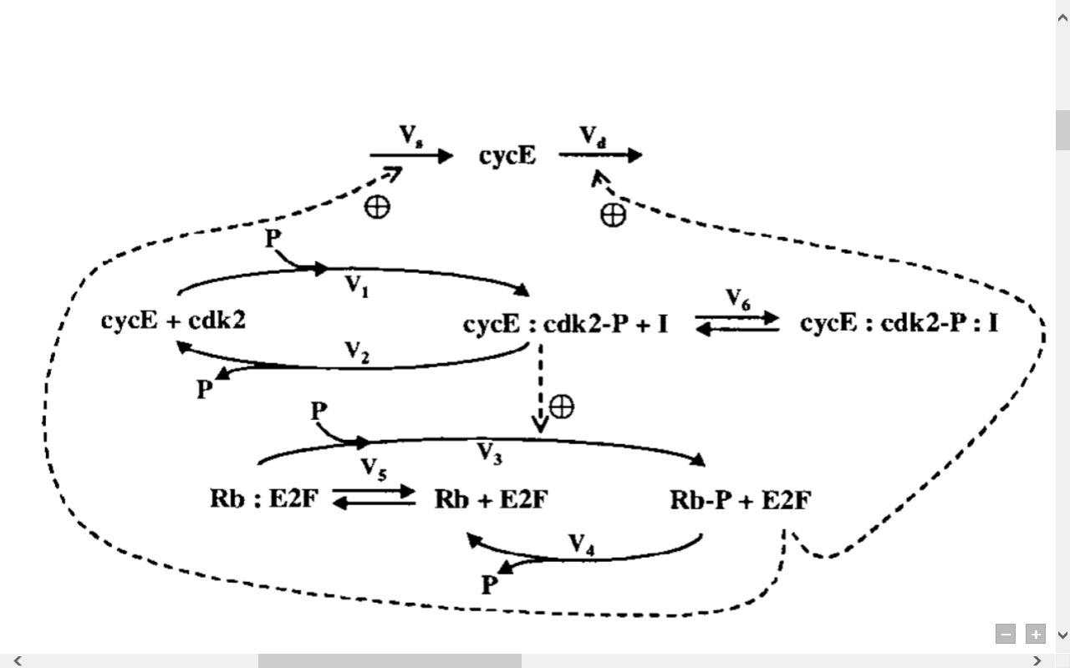
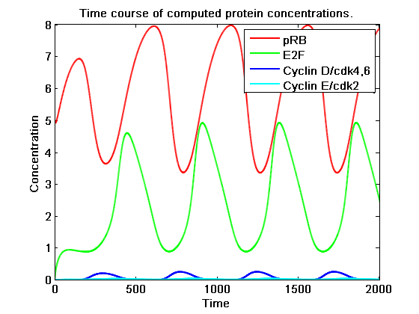
Negative Feedback to show cell cycle oscillation
Couple of positive feedback mechanism to a negative feedback loop shows cell cycle oscillation
Require more study to develop the mechanism on how cyclins repressed by E2F

Slide 18
Citation
Thank you!
Questions?
18

